Slide 1
Hacker Techniques, Tools, and Incident Handling
Chapter 8
Wireless Vulnerabilities

Slide 2
Learning Objective
Analyze vulnerabilities exploited by hackers.

Slide 3
Key Concepts
Wireless security and technologies
Bluetooth and security issues
Threats to wireless networks
Wireless hacking tools
Protecting wireless networks

Slide 4
The Importance of Wireless Security
Emanations
Use of radio frequency (RF) or radio techniques
Wireless signals travel through air, can easily be picked up by a notebook with a wireless card
Affected by atmospheric conditions, building materials, nearby devices
Bluetooth and Wi-Fi are common in notebooks, tablets, smartphones, and smart appliances/devices

Slide 5
The Importance of Wireless Security (Cont.)
Wi-Fi
Is a trademark introduced in 1999 and owned by the Wi-Fi Alliance to ensure a wireless technology conforms to the 802.11 standard
To bear the Wi-Fi logo, a product must pass testing procedures to ensure it meets 802.11 standards
Because a device uses the 802.11 standard does not mean it is “Wi-Fi;” it may not have undergone testing

Slide 6
A Brief History of Wireless Technologies
802.11
802.11a
802.11b
802.11g
802.11n
802.11ac
802.11 variants
Notes:
802.11 — The first wireless standard that saw major usage outside of custom deployments. It was used by large companies or educational institutions who could afford the equipment, training and implementation.
802.11b — Introduced two years after 802.11, this is the first widely adopted wireless technology. Performance was increased significantly.
802.11a — This standard was created in parallel with 802.11a but never saw widespread adoption because of the high cost and restricted range.
802.11g — A standard that combines the best of 802.11a and 802.11b. This standard has higher bandwidth (54 Mbps) combined with the 2.4-GHz frequency.
802.11n — A successor to 802.11g, this standard uses a method of transmitting signals known as multiple input and multiple output (MIMO).
802.11ac — The newest commercially available wireless standard, this standard increased wireless communication speed and reliability by using connections in the 2.4-GHz and 5-GHz bands at the same time.
802.11 variants — There are continual improvements in 802.11 protocol standards including changes to frequency used, bandwidth, compatibility, range and technical data rate. Current variants in review can be viewed by searching for “IEEE 802.11 standard variants.”

Slide 7
Other Wireless Technologies
Bluetooth
Designed to be a short-range networking technology that connects devices together
Connections allow devices to talk over a distance of no more than 10 meters with low bandwidth requirements
A personal area network (PAN) technology that allows mobile devices to connect to accessories
Bluetooth Low Energy (BLE)
A more useful version of Bluetooth that requires less energy to operate

Slide 8
Other Wireless Technologies (Cont.)
WIMAX
Designed to deliver Internet access over the last mile to home or businesses that might not be able to get access otherwise
Not designed for use with local area networks (LANs)
A metropolitan area network (MAN) technology

Slide 9
Working With and Securing Bluetooth
Bluetooth
Emerged in the mid-1990s
Is flexible
Works well to link devices wirelessly
Has problems with security but supports techniques that enforce security to make enabled devices less vulnerable

Slide 10
Working With and Securing Bluetooth (Cont.)
Bluetooth uses:
Connections between mobile phones and hands-free headsets and earpieces
Low-bandwidth network applications
Wireless mice and keyboards
Global Positioning System (GPS) connections
Bar code scanners
A replacement for infrared
A supplement to universal serial bus (USB) applications
Wireless bridging and wireless modems
Video game consoles

Slide 11
Bluetooth Security
Technology designed to include security measures
Presence of security does not mean they it’s used
Owners and administrators should always review security options and evaluate how they apply

Slide 12
Trusted Devices
Personal device you own such as mobile phone, tablet, or laptop
Company devices such as a printer or wireless environmental monitoring device
Device that can exchange data without asking for permission

Slide 13
Discoverable Devices
Discoverability feature is part of the Bluetooth protocol
Can be seen by other Bluetooth devices that are in range
Attackers can attach to Bluetooth devices and steal data
Devices should be set to non-discoverable as a default

Slide 14
Bluejacking, Bluesnarfing, and Bluebugging
Bluejacking
Allows someone authorized or unauthorized to send messages to a mobile device
Bluesnarfing
Used to steal data from a Bluetooth-enabled mobile device
Bluebugging
Attackers use the device being attacked for more than just accessing data (making phone calls or sending text messages, for example)

Slide 15
Viruses and Malware and More
Viruses and malware
Viruses leverage the discoverability to feature to locate and infect nearby devices
Mobile malware is a lucrative business
Traditional PC anti-malware software now produce mobile versions of their products
Securing Bluetooth
Bluetooth makers are providing tools to use technology safely
Discovering
Disable discoverability once you establish pairing between devices

Slide 16
Working with Wireless LANs
CSMA/CD Versus CSMA/CA
Role of APs
Service set identifier (SSID)
Association with an AP
Authentication
RADIUS
Network setup options
Ad Hoc Network
Infrastructure Network
Notes:
CSMA/CD Versus CSMA/CA —In networks based on the Ethernet standard (802.3), stations transmit information using Carrier Sense Multiple Access with Collision Detection (CSMA/CD) method. Wireless networks based on the 802.11 standard use the Carrier Sense Multiple Access with Collision Avoidance (CSMA/CA).
Role of APs — Wireless clients connect to Aps to gain access to the network.
Service Set Identifier (SSID) — SSIDs are used to identify a network ensuring that clients can locate the correct wireless local area network (WLAN).
Association with an AP — Association occurs when a wireless client has the SSID preconfigured for the network it is supposed to be attaching to. Association must take place before a wireless client can connect to a wireless account.
Authentication — Before the association process takes place, authentication should be performed. Authentication can be accomplished through open or preshared keys.
Remote Authentication Dial-In User Services (RADIUS) — RADIUS is used to offload authentication of wireless users and provide an additional layer of security in the absence of network wires. RADIUS is designed to centralize authentication, authorization and accounting, or AAA.
Network Setup Options
Ad hoc network —A peer-to-peer network in which each client can attach to any other client to send and receive information.
Infrastructure network — Networks that use an AP that each client associates with.

Slide 17
Threats to Wireless LANs
Wardriving
Misconfigured security settings
Unsecured connections
Rogue APs
Promiscuous clients
Wireless network viruses
Notes:
Wardriving —The process of an attacker traveling through an area with the goal of detecting wireless AP or devices. Similar attacks include warwalking, warbiking, warflying, and wardroning.
Misconfigured security settings —Most consumer-grade devices are preconfigured for convenience and not security. All networks should be configured properly.
Unsecured connections — Transmitting data over unsecured Aps can be problematic, and users who leave wireless access technologies, such as Bluetooth enabled on a notebook or mobile device, may be open to data theft and more.
Rogue APs — Rogue APS are installed without authorization. Rogue Aps bypass organization security controls leaving them unmanaged, unknown, and unsecured.
Promiscuous clients — Promiscuous client are Aps that are configured to offer strong signals and the offer of good performance.
Wireless network viruses — Wireless viruses replicate quickly and use the wireless network to sump from system to system.

Slide 18
Countermeasures to WLAN Threats
Firewalls
Antivirus
VPNs
Training
IPSec

Slide 19
Internet of Things (IoT)
A network of devices that are connected via networking
Devices on the network are accessible worldwide
Smart devices
Attackers can use devices to penetrate personal or corporate networks or compromise the devices themselves

Slide 20
Internet of Things (IoT) (Cont.)
Smart Devices Accessible over the Internet
Lights
Thermostats
Refrigerators
Laundry appliances
Home entertainment systems
Security systems
Video cameras
Sensors (temperature, smoke, fire, motion, vibration, light, etc.)
Vehicles
Wearable devices (watches, glasses, medical devices, exercise monitors, etc.)

Slide 21
Wireless Hacking Tools
Kismet
NetStumbler
Medieval Bluetooth Scanner
inSSIDer
CORE Impact
GFI LanGuard Network Security Scanner
coWPAtty
Wireshark
WiFi Pineapple
Ubertooth One (for Bluetooth)

Slide 22
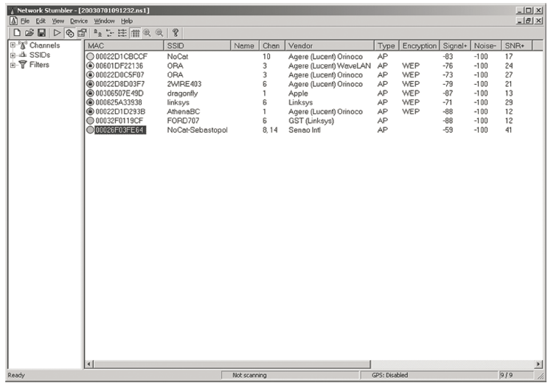
NetStumbler Interface
Notes:
A common software-based tool for locating 802.11 wireless networks
Designed to detect any 802.11a/b/g/n wireless network
Not currently being updated and does not officially support newer wireless protocols
Can use GPS location information to map out the location of the APs it detects

Slide 23
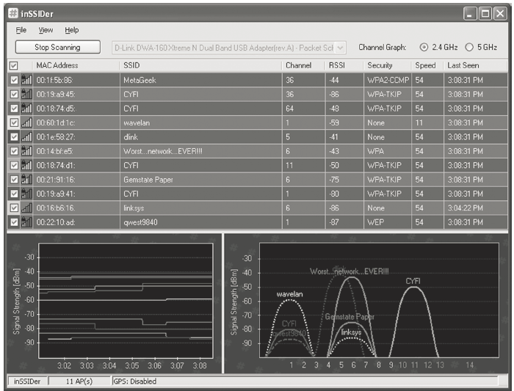
inSSIDer interface
Notes:
Performs wireless network scanning
Can be used with multiple current versions of Microsoft Windows
Uses the Native Wi-Fi application programming interface (API) and current wireless network card
Detects and supports the latest 802.11 protocols
Can group by Media Access Control (MAC) address, SSID, channel, received signal strength indicator (RSSI), and “time last seen”
Inspects your WLAN and surrounding networks to troubleshoot competing APs
Tracks the strength of received signals in dBm (a measurement of decibels) over time
Filters APs in an easy-to-use format
Highlights APs for areas with high Wi-Fi concentration
Exports Wi-Fi and GPS data to a Keyhole Markup Language (KML) file to view in Google Earth

Slide 24
Protecting Wireless Networks
Change default AP security
Place AP to cover only areas it needs to
Use wireless directional antennas, such as Yagi antenna
Educate employees about the dangers of installing rogue APs

Slide 25
Protecting Wireless Networks (Cont.)
Use protection for transmitted data
Wired Equivalent Privacy (WEP)
Wi-Fi Protected Access (WPA)
Wi-Fi Protected Access version 2 (WPA2)
Use Media Access Control (MAC) filtering

Slide 26
Summary
Wireless security and technologies
Bluetooth and security issues
Threats to wireless networks
Wireless hacking tools
Protecting wireless networks

